Slide 1


React JS
(Adv props)
Lecture-12

Slide 2
Today’s Agenda
How To Iterate Over Arrays In JSX
Using map() Method Of Array
Default props
Exercises

Slide 3
Challenge !
To understand the next topic , consider the following scenario:
Create a Course component
Declare two props in it called name and title
The prop name will hold the course name and the prop title will hold the names of course titles
Finally we have to render the Course name followed by titles rendered as an unordered list

Slide 4
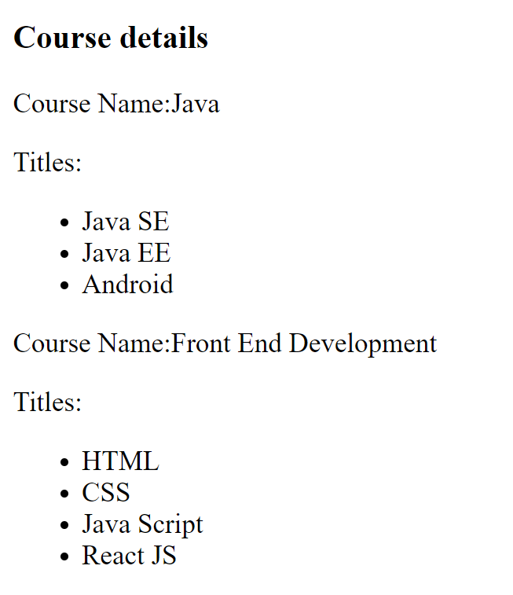
Desired Output

Slide 5
Solution 1
One way to do this is to iterate over the titles array using forEach() method and generate <li> tags with course titles.
And then push these <li> tags in another array.
Finally render this array

Slide 6
Looping In JSX
App.js
class App extends React.Component {
render() {
return (
<div>
<h3>Course details</h3>
<Course name="Java" titles={["Java SE", "Java EE", "Android"]} />
<Course
name="Front End Development"
titles={["HTML", "CSS", "Java Script", "React JS"]}
/>
</div>
);
}
}
let mydiv = document.querySelector("#root");
ReactDOM.render(<App />, mydiv);

Slide 7
Looping In JSX
Course.js
class Course extends React.Component {
render() {
let subj = [];
this.props.titles.forEach((s) => {
subj.push(<li>{s}</li>);
});
return (
<div>
<p>Course Name:{this.props.name}</p>
<p>
Titles:<ul>{subj}</ul>
</p>
</div>
);
}
}

Slide 8
Solution 2
Although the previous code worked but we can reduce our coding efforts by using another approach
The most common way of iterating over an array is by using the map() method

Slide 9
What Is map() Method ?
The map() method in JavaScript belongs to Array object .
It has the following syntax:
brr=arr.map( call_back_fn )
It accepts a callback function as argument
Calls that callback function for each element of the parent array
Collects the result returned by the callback function
Finally it returns this result as a new array

Slide 10
What Is map() Method ?
To understand working of map() , consider the following example:
WAP to double the value of every element of an array and print these doubled values

Slide 11
Using map() Function
Index.html
<script>
function f1(n) {
return n * n;
}
const numbers = [1, 2, 3, 4, 5];
const doubled = numbers.map(f1);
document.write(numbers);
document.write("<br>");
document.write(doubled);
</script>

Slide 12
A More Clean Version
index.html
<script>
const numbers = [1, 2, 3, 4, 5];
const doubled = numbers.map((n) => n * n);
document.write(numbers);
document.write("<br>");
document.write(doubled);
</script>

Slide 13
Course Component Using map()
Course.js
class Course extends React.Component {
render() {
let subj = this.props.titles.map((s) => {
return <li>{s}</li>;
});
return (
<div>
<p>Course Name:{this.props.name}</p>
<p>Titles:</p>
<ul>{subj}</ul>
</div>
);
}
}

Slide 14
Another Way Of Using map()
Course.js
class Course extends React.Component {
render() {
const { titles } = this.props;
return (
<div>
<p>Course Name:{this.props.name}</p>
<p> Titles:</p>
<ul>
{titles.map((s) => (
<li>{s}</li>
))}
</ul>
</div>
);
}
}

Slide 15
Exercise
Create a Student component
Declare 4 props in it called name , age , subjects and marks
The prop name will hold the student name and the prop age will hold age of the student and the props subjects and marks will hold 3 subject names and 3 marks
Finally we have to render the Student Component with all the props and the total and result as pass or fail.
The criteria of passing is that total must be >=150

Slide 16
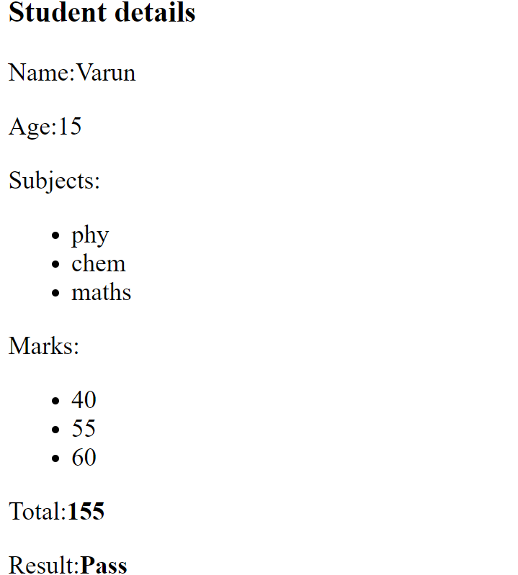
Desired Output

Slide 17
Default Props
To understand working of defaultProps, consider the files App.js and Greetings.js given in next few slides and predict the output of the code

Slide 18
Default Props
App.js
class App extends React.Component {
render() {
return (
<div>
<Greetings who="Varun" from="Deepak" />
<Greetings who="Sachin" />
<Greetings from="Ravi" />
<Greetings />
</div>
);
}
}
let mydiv = document.querySelector("#root");
ReactDOM.render(<App />, mydiv);

Slide 19
Default Props
Greetings.js
class Greetings extends React.Component {
render() {
return (
<h3>
Good Evening {String(this.props.who)} from {String(this.props.from)}!
</h3>
);
}
}

Slide 20
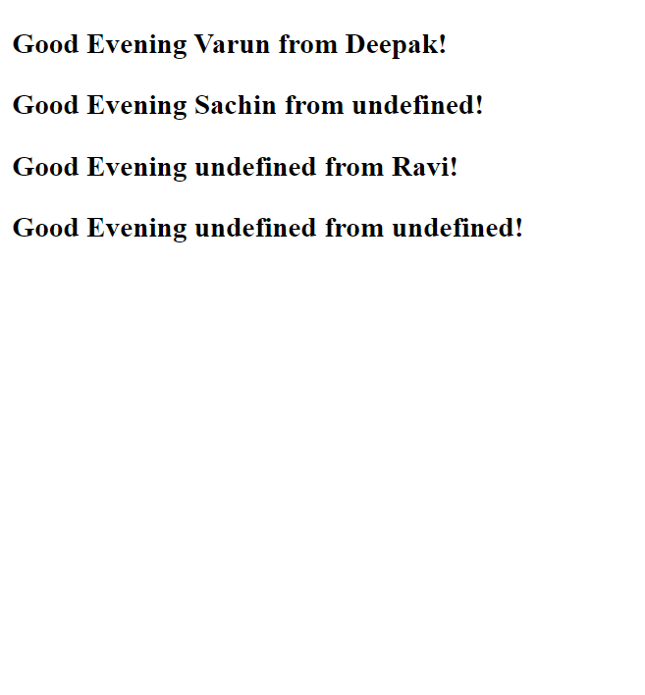
Output

Slide 21
Default Props
As we can see , React has generated the value undefined for all the props which were not passed while component was getting rendered.
To overcome this problem we can use the concept of default props

Slide 22
Default Props
The defaultProps is a React component property that allows us to set default values for the props argument.
If the props property is passed, it will be changed , otherwise the value set in defaultProps is used.

Slide 23
Syntax Of Default Props
class <Classname> extends React.Component
{
static defaultProps={ <prop_name>:<value> , , , };
. . . . .
}

Slide 24
Modified Greetings.js
Greetings.js
class Greetings extends React.Component {
static defaultProps = {
who: "Everyone",
from: "Team SCA",
};
render() {
return (
<h3>
Good Evening {String(this.props.who)} from {String(this.props.from)}!
</h3>
);
}
}

Slide 25

Output

Slide 26
Using Default Props
With Functional Components
To use the concept of default props with functional components we have two approaches:
Using default parameters with destructuring.
Using defaultProps property

Slide 27
Using Default Parameters
index.html
<script type="text/babel">
function Greetings({ who = "Everyone", from = "Team SCA" }) {
return (
<h3>
Good Evening {String(who)} from {String(from)} !
</h3>
);
}
let mydiv = document.querySelector("#root");
ReactDOM.render(<Greetings />, mydiv);
</script>

Slide 28
Using defaultProps Property
index.html
<script type="text/babel">
function Greetings(props) {
return (
<h3>
Good Evening {String(props.who)} from {String(props.from)}!
</h3>
);
}
Greetings.defaultProps = {
who: "Everyone",
from: "Team SCA",
};
let mydiv = document.querySelector("#root");
ReactDOM.render(<Greetings />, mydiv);
</script>

